Slide 1

PROJECT DEFENSE COMPUTER SCIENCE DEPARTMENT KNUST
PROJECT TOPIC:
E – SHOPPER
(MULTILINGUAL E-COMMERCE WEBSITE)
PRESENTED BY: WILLIAM KPABITEY KWABLA - 2565814
SUPERVISED BY: MR. KWAKU AGYAPONG PAABI

Slide 2
CONTENT:
INTRODUCTION
PROBLEM STATEMENT
AIM AND OBJECTIVES
PROJECT SCOPE AND BENEFICIARIES
SYSTEM AND APPLICATION ARCHITECTURE
RECOMMENDATIONS AND CONCLUSION
PROJECT DEMONSTRATION

Slide 3
INTRODUCTION
E-Shopper is a multilingual e-commerce website to make online shopping easier for online shoppers and also expand the market of shop owners.

Slide 4
PROBLEM STATEMENT
Modern e-commerce websites are restricted to more often than not, to the language of the country the developers are from. People who do not understand the native language (of the developers) find it very difficult to benefit from these websites.

Slide 5
AIM
The aim of the project is to bring convenience to the doorstep of online shoppers.
OBJECTIVES
To make buying and selling easier.
To enable customers from different countries shop with ease from their country or when in Ghana.
To provide shop management with an effective and efficient system to handle client’s data and request.
To help expand the market of shops and make it available to a worldwide audience.

Slide 6
BENEFICIARIES
Online Shoppers.
Shop Owners.
PROJECT SCOPE
Localization and Internationalization of languages for other countries.
Automated Payment using PayPal with email notification of orders sent to customers.
Recommendation engine based on the previous products bought by customer.
Backend to check inventory and manage the shop.

Slide 7
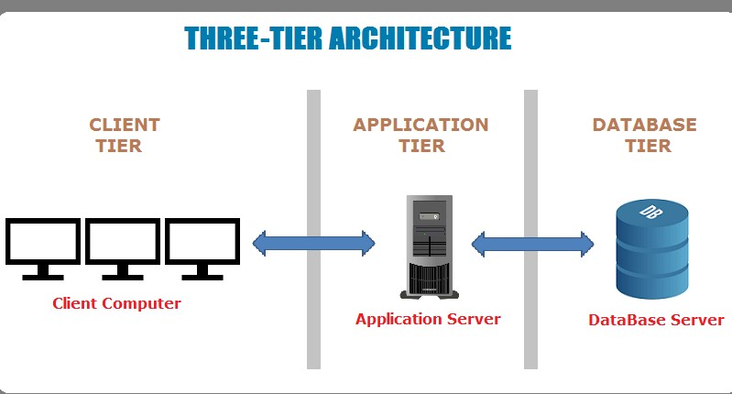
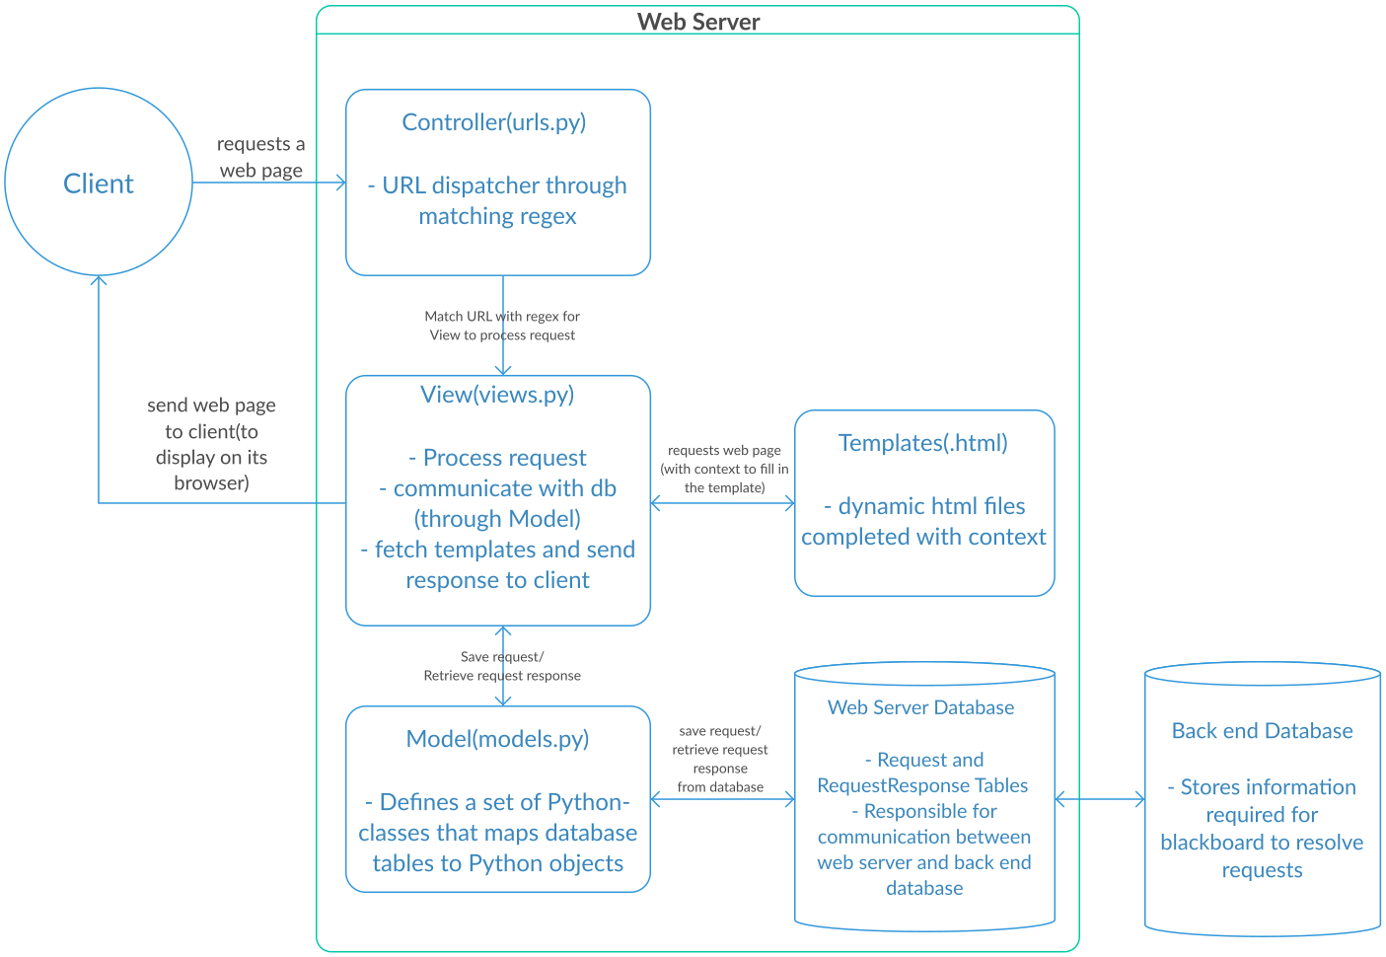
SYSTEM ARCHITECTURE
APPLICATION ARCHITECTURE

Slide 8
DEVELOPMENT TOOLS
Python – For the backend
Django – Python Web Framework for web development.
Bootstrap – HTML, CSS and JavaScript for the Front-end development.
PayPal – For the payment of orders.
Postgresql – Database for the storage of data.

Slide 9
RECOMMENDATIONS AND CONCLUSION
One recommendation is that more payment options should be added especially for the mobile money section. We have options only for either debit or credit cards.
THANK YOU.
Next: Software Demonstration

Slide 10
REFERENCES
10ecommercetrends. (2017, November 20). 10 Ecommerce Trends 2017. Retrieved from 10 Ecommerce Trends : http://10ecommercetrends.com/
Ahiabenu, K. (2017, November 15). How can e-commerce transform your business? Retrieved from Graphic Online: https://www.graphic.com.gh/features/opinion/how-can-e-commerce-transform-your-business.html
Amazon (company). (2017, November 20). Retrieved from Wikipedia: https://en.wikipedia.org/wiki/Amazon_(company)
ARM Worldwide . (2017, November 17). What are the E-Commerce Tech Trends in 2018. Retrieved from ARM Worldwide: https://armworldwide.com/e-commerce-tech-trends/
Boampong, P. B. (2017, November 13). Breakthrough of E-commerce in Ghana. Retrieved from Ghana Web: https://www.ghanaweb.com/GhanaHomePage/NewsArchive/Breakthrough-of-E-commerce-in-Ghana-347247
Codecademy. (2018, April 05). MVC: Model, View, Controller. Retrieved from Codecademy: https://www.codecademy.com/articles/mvc

